Slide 1

Mitigating the Impact of Rising Protectionist Tendencies: Role of Central Banks and the Continental Free Trade Area in Promoting Intra-African Trade
Continental Seminar of the Association of African Central Banks (AACB)
Intercontinental Resort Balaclava, Mauritius, 6-8 May 2019
May 6, 2019
Abdoul Aziz Wane
Director AFRITAC South and Africa Training Institute
International Monetary Fund

Slide 2
Is the African Continental Free Trade Area a Game Changer for the Continent?
Chapter 3 of the International Monetary Fund April 2019 Sub-Saharan Africa Regional Economic Outlook

Slide 3
What is the AfCFTA?

Slide 4
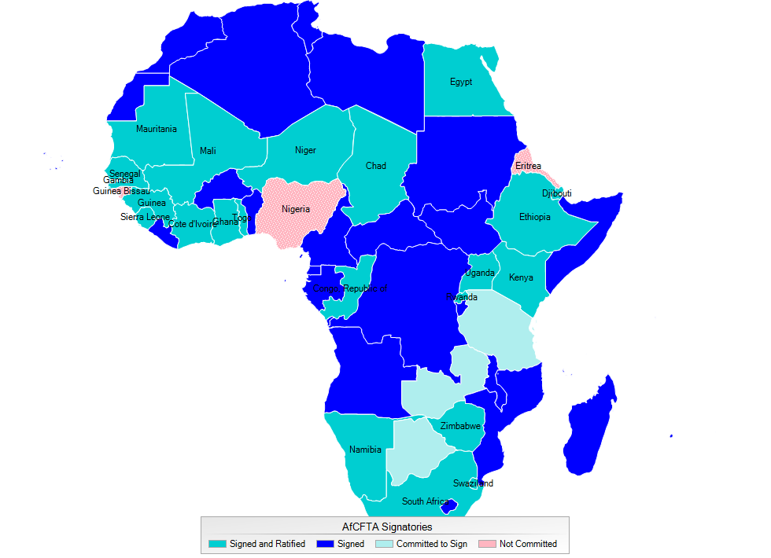
A Large Free Trade Area for the Continent
A free trade area of 55 countries, 1.2 billion people with a combined GDP of US$2.5 trillion
A ratified agreements with some key tools yet to be finalized:
  Tariff reductions on 90 percent of tradable items
  Services trade liberalization
  Clear rules of origin
  Identification of non-tariff barriers
At a later stage: free movement of labor, capital and ultimately a currency union

Slide 5
African Regional Trade in Perspective

Slide 6
Regional Trade Integration Comparable to Other Developing Regions…
Intraregional Trade in Selected Regions, 2007–17
(Average share of total imports originating from the region)
Sources: United Nations COMTRADE database; and IMF staff calculations.
Note: ASEAN = Association of Southeast Asian Nations; LAIA = Latin American Integration Association; NAFTA = North American Free Trade Agreement; PAFTA = Pan-Arab Free Trade Area.

Slide 7
…and More Diversified than Africa’s Trade with the Rest of the World

Slide 8
Concentrated and with Some Large Economies Poorly Integrated
Trade Integration, 2015
Sources: United Nations COMTRADE database; and IMF, World Economic Outlook database
Note: Countries ranked from largest to smallest GDP, excluding South Africa (appearing as a residual). For each country, trade share is the average of exports and imports as a share of total African regional trade. Relative regional trade integration defined as the ratio of the share of regional trade over the share of regional GDP. See page vi for country abbreviations table.
=> Potential for further expansion in regional trade

Slide 9
Near-Zero Tariffs in RECs and Substantial Non-Tariff Bottlenecks
Africa: Average Tariff Rates by Regional Economic Community, 2010–17
Nontariff Trade Costs, 2015
(Tariff equivalent)
Sources: UNCTAD Trade Analysis Information System; and IMF staff estimates.
Source: ESCAP - World Bank Trade Cost database.
=> Tariffs matter but other factors affect regional trade flows too

Slide 10
Potential Impact of The AfCFTA on Trade

Slide 11
Some room for further regional trade integration

Slide 12
Structural and Policy-Induced Factors Imply Low Levels of Trade In Africa
Role of Country Features in Affecting Regions' Trade Flows
(Median and interquartile range of country fixed effects from the gravity model)
Source: IMF staff estimates.

Slide 13
Addressing non-tariff bottlenecks key to deepen regional trade integration

Slide 14
Tariff Reductions Increase Regional Trade, but Non-Tariff Bottlenecks Matter Even More
Elasticity of Intraregional Trade
(Tariff equivalent)
Sources: UNCTAD Trade Analysis Information System; and IMF staff estimates.

Slide 15
Poor Infrastructure and Logistics Affect the Impact of Tariff Reductions on Trade
Infrastructure and Trade Logistics Gaps in Africa

Slide 16
Larger Welfare Payoffs From Reducing Non-Tariff Bottlenecks
Main results from CGE models
With tariff reductions, intra-African trade increases, but limited welfare and growth effects
Reducing NTBs/trade costs improves welfare effects substantially
Results vary greatly across countries. Very few countries worse off in absolute levels.

Slide 17
The AfCFTA Can Affect Countries Unevenly

Slide 18
Structural reforms can help strengthening the impact of the AfCFTA on trade

Slide 19
Combining Trade and Structural Policies Increases Payoffs for Less Diversified Economies
Additional GDP Impact of Trade Expansion under Structural Reform Scenarios, Agricultural Exporter
(Percent)
Source: IMF staff estimates.
Note: Trade expansion is defined as the increase in openness (exports plus imports to GDP). "Limited reform scenario" implies a 3 percent additional long-term effect on GDP levels, while "comprehensive reform scenario" implies a 7 percent additional increase in GDP.

Slide 20
limited effects on income distribution in Africa

Slide 21
Trade Integration Unlikely to Increase Inequality in the Medium Term
Higher income inequality in the short term
But, the inequality-increasing effect fades away over the medium term
Informality increases inequality but appears to reduce the effects of trade liberalization on inequality
Impact on African economies not substantially different from other countries.

Slide 22
Small reductions in fiscal revenue with exceptions in some countries

Slide 23
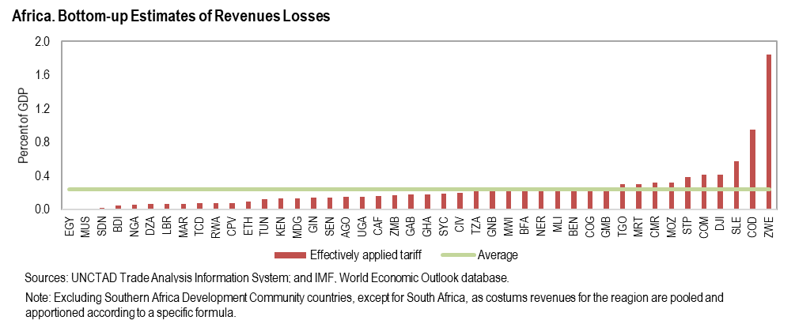
Limited Revenue Losses, with Few Exceptions

Slide 24
TRADE TENSIONS AND MONETARY POLICY RESPONSE
How can monetary policy mitigate the adverse impacts of rising protectionism?

Slide 25
Views from a Renowned Policymaker
“For monetary policy, the implications of protectionist measures depend on the balance of their effects on demand, supply, the exchange rate and import prices. Those, in turn, will depend on factors such as the extent to which measures are expected to be a temporary skirmish or the new normal, how quickly tariffs are passed through to prices, whether they hit productivity, and whether there are any non-linear effects – for example arising from disruptions to supply chains or wholesale obsolescence of plant and equipment”.
Mark Carney, Governor of the Bank of England in “From Protectionism to Prosperity”, Speech given at Northern Powerhouse Business Summit July 5th 2018.
Mark Carney, Governor of the of the Bank of England, Northern Powerhouse Business Summit — Great Exhibition of the North 5 July 2018

Slide 26
Policy Uncertainty and Trade Tensions

Slide 27
Policy Uncertainty and Trade Tensions
To calibrate this effect WEO uses the Baker-Bloom-Davis overall Economic Policy Uncertainty measure and its estimated impact on investment in the United States
  A 1 standard deviation increase (roughly 1/6 of the global financial crisis) leads to 1 percent drop in the level of investment in the US.
  The impact in other countries is scaled by their trade openness relative to the US—countries more dependent on trade see a larger fall in investment than does the United States.

Slide 28
World Real GDP in Trade Tensions Scenario
Percent deviation from control
Baseline corresponds to measures that have already been implemented (tariffs on aluminum, steel, etc.

Slide 29
Estimates of Potential Impacts of Protectionism
Source: “From Protectionism to Prosperity” Speech by Mark Carney, Governor of the Bank of England, at the Northern Powerhouse Business Summit – Great Exhibition of the North, 5 July 2018.

Slide 30
Macro Effects from a 25 Percent Increase in Tariffs Affecting All US–China Trade: Bilateral Trade Flows with Third Countries

Slide 31
How should monetary policy react to these expected developments?

Slide 32
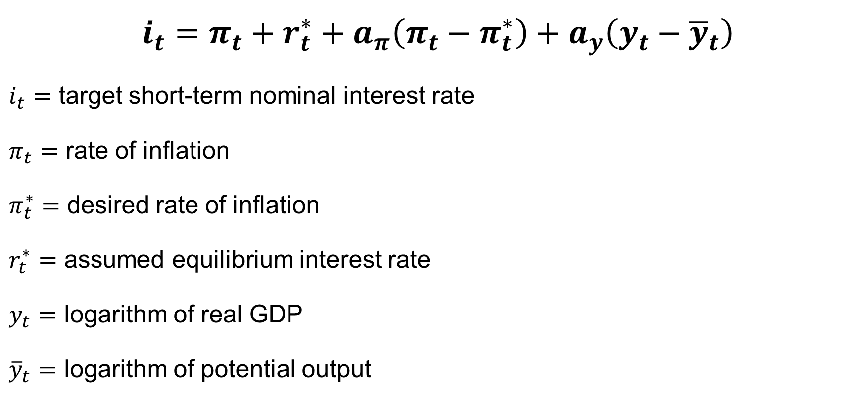
Taylor Rule and Monetary Policy Dilemma under Protectionism
$$i_{t}=π_{t}+r_{t}^{∗}+a_{π}\left(π_{t}−π_{t}^{∗}\right)+a_{y}\left(y_{t}−{\overline{y}}_{t}\right)$$
$i_{t}=$ target short-term nominal interest rate
$π_{t}=$ rate of inflation
$π_{t}^{∗}=$ desired rate of inflation
$r_{t}^{∗}=$ assumed equilibrium interest rate
$y_{t}=$ logarithm of real GDP
${\overline{y}}_{t}=$ logarithm of potential output

Slide 33
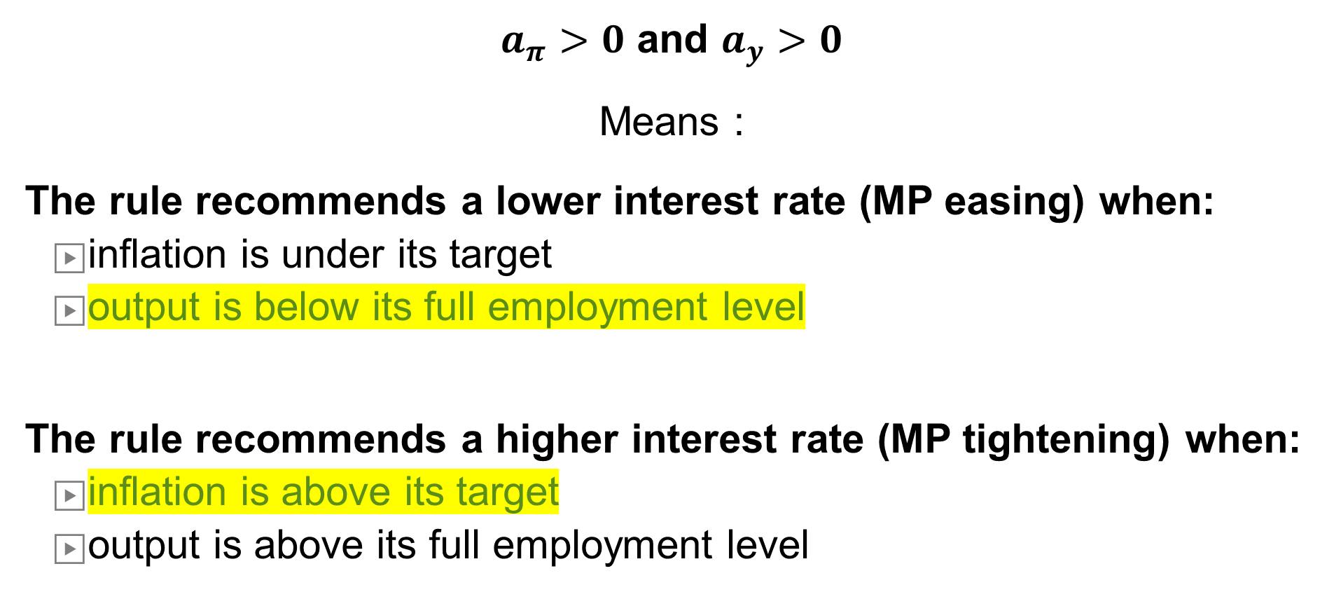
The policy dilemma
$a_{π}>0$ and $a_{y}>0$
Means :
The rule recommends a lower interest rate (MP easing) when:
    inflation is under its target
    output is below its full employment level
The rule recommends a higher interest rate (MP tightening) when:
    inflation is above its target
    output is above its full employment level

Slide 34
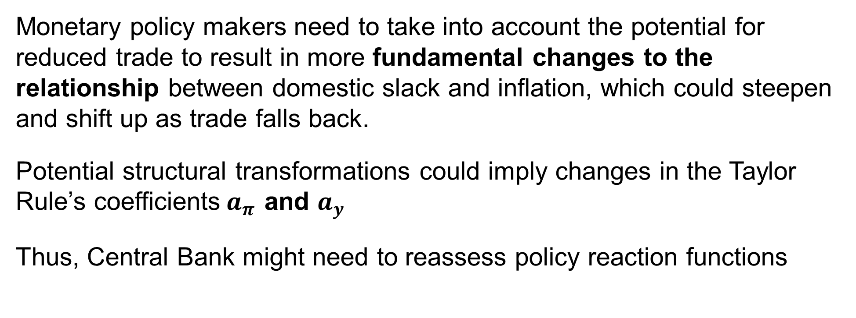
Adapting to Structural Changes from Trade Tensions
Monetary policy makers need to take into account the potential for reduced trade to result in more fundamental changes to the relationship between domestic slack and inflation, which could steepen and shift up as trade falls back.
Potential structural transformations could imply changes in the Taylor Rule’s coefficients$a_{π}$ and $a_{y}$
Thus, Central Bank might need to reassess policy reaction functions

Slide 35
TRADE TENSIONS AND THE AFRICA CONTINENTAL FREE TRADE AGREEMENT
How can the AfCFTA mitigate the adverse impacts of rising protectionism?

Slide 36
Measuring Spillovers from Tariffs
Impact of tariffs on production, employment, and productivity, accounting for how firms operating in a global value chain context are affected, both domestically and internationally. Four measures :
  The upstream tariff is the average cumulative tariff applied to the intermediate inputs as a share of the sector’s output.
  The domestic protection tariff captures the average tariff (import-weighted) imposed on imports that compete with the output of the domestic sector.
  The downstream tariff is the average cumulative tariff the sector’s output faces when exported either directly or indirectly through other (intermediate-output-using) sectors and countries.
  The diversion tariff captures the weighted average tariff that partner countries impose on all other suppliers except the country-sector in question.

Slide 37
Understanding Spillovers from Tariffs
The empirical analysis (35 countries and 13 manufacturing sectors) suggests that tariffs have significant and economically sizable effects both along the value chain and horizontally on:
Real value added,
Employment, and
Productivity

Slide 38
Sign and Significance of Tariffs on Economic Variables in April 2019 World Economic Outlook

Slide 39
Negative Spillovers & Opportunities
Closer integration into global value chain Vs. Trade Diversion
  Closer integration: Trade wars cause collateral damage to companies in third countries because of globally integrated supply chains. The effects go through downstream and upstream tariffs.
    AfCFTA bolsters integration of African goods into global value chain. Countries less integrated in global trade before could be adversely affected by AfCFTA. For example: the price of Guinea’s imports from South Africa (well integrated into global value chain) would increase because of the impacts of the tariffs between US and China. Before AfCFTA, the tariff between Guinea and South Africa would mitigate the impact on Guinea.
  Trade diversion: A trade dispute could provide opportunities for companies in third countries.
    African agriculture exports to China could increase, for example, as they replace products once sourced from the US. African manufacturing companies could benefit from rising export opportunities in the US.

Slide 40
Magnitude depends on structure of imports and their integration in global value chain
Net effect of AfCFTA on Africa’s exports could be positive because of prominence of non-manufacture exports (less integrated in GVC) that would benefit from trade diversion. Manufactured exports small in total exports.

Slide 41
Messages

Slide 42
Key Messages
Tariff reductions can play a significant role in fostering intraregional trade, if applied to a large proportion of trade…
…and should be complemented by policies to reduce non-tariff bottlenecks (e.g. logistics)
Policies should address the adjustment costs of trade integration:
  Boost agricultural productivity in less diversified economies
  In a few countries, mobilize domestic tax revenue to offset losses
  Use targeted social programs and training schemes to ease workers mobility across industries to mitigate adverse effects on income distribution
  Reassess central banks’ policy reaction functions
  Capture opportunities from trade diversion by strengthening competitiveness of relevant industries.

