Slide 1
FINANCIAL INCLUSION
2021

Slide 2
Enabling Environment
Financial Inclusion definition in CBE Law
Access
Regulation Issued
Consumer Protection Regulations
Simplified KYC Regulations
Opening Account for youth starting 16 years of age
Saving and lending through Mobile Wallet
Establishing Financial Inclusion departments within Banks
Default exemption initiative for Individuals and corporates
MSMEs initiative, obligating banks to dedicate 25% from their loan portfolio for MSMEs
Regulation in progress
Agent Banking
Tier 2 banks
Digital Banking
Facilitate product and services for people with disabilities
Regulating the use of non-cash payment methods Law
Usage
Quality
Consumer protection

Slide 3
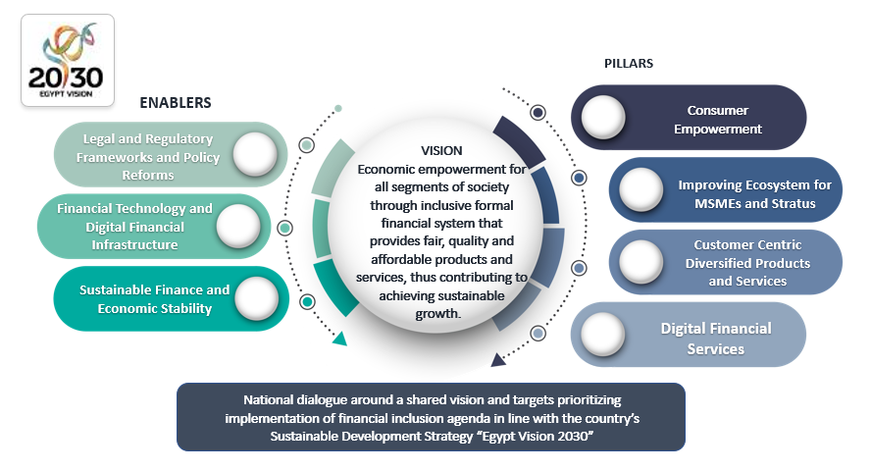
Draft framework for financial Inclusion Strategy

Slide 4
Supply Side Data
19.4%
33.8%
52.8%
2014
2017
2020

Slide 5
Projects
Village Saving and loan Associations:
Low income women in rural areas
World Food Program, Smallholder Farmers Project “Land Consolidation”
Financial Inclusion Events:
Targeting citizens in the poor and marginalized villages
Financial Literacy:
Targeting Citizens, Banking staff, Policy Makers

Slide 6
Financial Inclusion and correlation with Non-performing Loan
Problem:
low level of financial awareness regarding money and debt management, as well as lack of entrepreneurial skills.
Applying for loans that exceeds their business needs, which lead to over-indebtness
Solution:
Financial awareness
Granting loans in tiers
Diversity of repayments schemes depending on project type
Close Follow up by loan officers to guarantee proper loan utilization

Slide 7
Thank you!

