Slide 1
SCFSD/Pres/DLP/7/1/1/1
Resolution of Non-Performing Loans: What Strategies for African Central Banks
AACB Seminar :June 2021 Imanuel Hawanga

Slide 2
OUTLINE
Concern of NPL trend
Factors of Policy Determination
NPL Recovery options
Conclusion

Slide 3
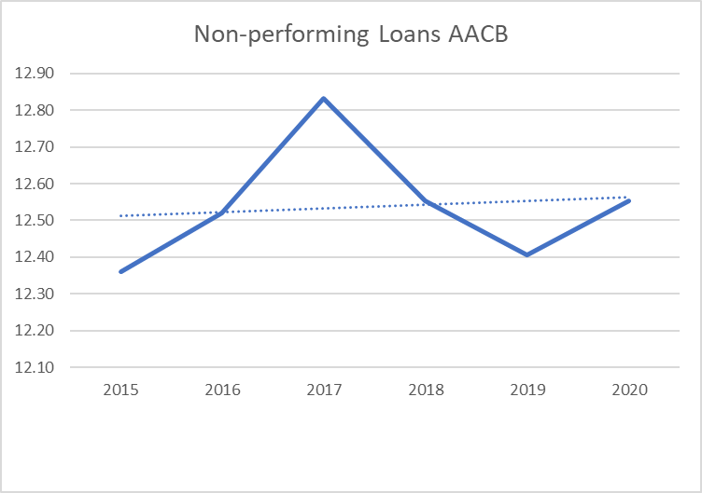
NON-PERFORMING LOANS LEVELS
Trigger level of NPLs = systemic impact on financial systems
Stress testing remains key

Slide 4
KEY FACTORS FOR POLICY DETERMINATION
Suitability of policy instruments is determined by :
• the size of the NPL problem in relation to banks’ loss-absorbing capacity;
• the macroeconomic conditions and structural banking sector issues;
• the type of assets under NPL status;
• the fiscal space for providing support to the banking sector, if needed; and
• legal and judicial restrictions.

Slide 5
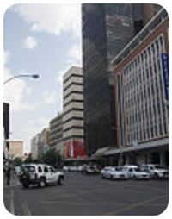
NPL Recovery Options
Debtor focused
Bank focused
Direct Sales
Debt restructuring
Securitization
Asset Management Companies
Write-offs
Asset protection schemes

Slide 6
RECOMMENDATIONS
Determination of systemic levels
Mapping your country characteristics
Adoption of relevant policy instruments

Slide 7
SCFSD/Pres/DLP/7/1/1/1

