Slide 1
Continental Seminar: Association of African Central Banks
Renewed Protectionism Tendencies: Implications on Macroeconomic Policy in Africa: Botswana Experience
May 6, 2019

Slide 2
Outline
Structure and performance of the Botswana economy
External Sector
Impact of Trade Protectionism
Conclusion

Slide 3
Structure and Performance of the Botswana Economy
(Sectoral Composition of GDP)
Mining has been and remains dominant; largest single sectoral contributor to GDP
Mining sectoral contribution dissipating due to recent weak performance and improved diversification in other sectors

Slide 4
Structure and Performance of the Botswana Economy
(GDP Growth: 2006 – 2018)
Growth in mining generally drives GDP growth, but recently has been performing poorly, while good performance in non-mining sectors supported overall growth

Slide 5
External Sector (Exports)
Botswana is a small open economy, with trade at about 75 percent of GDP in 2018
Exports
limited variety of goods dominated by diamonds
Diamonds average more than 70 percent of total exports

Slide 6
External Sector (Imports)
Wide range of goods and services imported for consumption and inputs in production
Since the relocation of the De Beers aggregation and sales services from the United Kingdom to Botswana in 2012 and 2013, respectively, diamonds also dominate imports

Slide 7
External Sector (Foreign Exchange Reserves)
Foreign exchange reserves have accrued from positive external and fiscal balances
The reserves generate sufficient import cover
Reserves accumulated to align public expenditure with planned development, capacity of the economy to absorb spending and the need to save for future spending and generations
Notes:
In addition to reserve sufficiency in terms of import cover, a substantial amount of reserves is directly due to government
Reserves also sufficient to cover external debt

Slide 8
External Sector (Current Account)
Revenue inflow from the Southern African Customs Union (SACU)
A surplus in the merchandise trade account

Slide 9
External Sector (Influence on Policy Posture)
Structural characteristics
Small, open economy and limited domestic market
Policy and strategy
Outward-looking industrialisation strategy: FDI, external markets; inputs and consumption goods
Fiscal conservatism and focus on saving funds generated from exhaustible resource: address vulnerabilities
Vulnerability to exogenous factors
Sectoral concentration: output and sources of revenue
Exchange rate policy: peg to trade partner countries and focus on stable real exchange rate – moderate volatility; support domestic industry

Slide 10
Impact of Trade Protectionism: Botswana Experience
Exchange rate policy:
Pula exchange rate is determined by movements of the basket currencies and the rate of crawl.
Movements of Pula exchange rate largely influenced by movements of the South African rand (largest weight in the basket).
The rand, among other EM currencies, is highly responsive to global factors and has been fluctuating aggressively at par with developments in the US & China trade negotiations.
Consequently, the Pula has been depreciating against the US dollar and other SDR constituent currencies, following the depreciation of the rand against the US dollar.

Slide 11
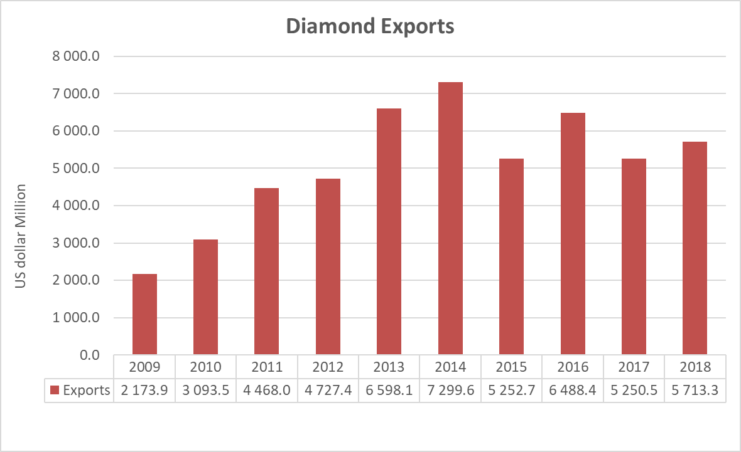
Impact of Trade Protectionism: Botswana Experience
Trade flows:
The trade dispute between US & China has affected the Chinese economic activity greatly
Both the US and China are Botswana’s major trading partners, especially in diamond trade
However, diamond exports in 2018 have not been affected

Slide 12
Conclusion
Botswana has exercised prudent financial management and generally accumulated budget surpluses
Strong external and fiscal positions, a well managed economy and low public debt as well as robust public institutions have allowed Botswana to maintain macroeconomic stability and sustainability
Trade disputes beyond the current situation pose a high risk on diamond trade and therefore on government revenue and balance of payments.

