Slide 1

‘Trade War and Protectionist Tendencies:
Implications on External Sector
Performance in Africa’
6 May 2019

Slide 2

Outline of Presentation
Latest IMF WEO Projections for Sub-Saharan Africa (SSA)
External sector developments in Africa (AfDB African Economic Outlook 2019)
Implications of rising protectionism on external sector performance in Africa
Conclusions
Q&A
Bank of Mauritius

Slide 3
Background/1
Growth in SSA projected to pick up from 3% in 2018 to 3.5% in 2019 and 3.7% in 2020.
  Anaemic growth in resource-dependent economies, including the largest, Nigeria, and South Africa.
  Variations among countries and regions.
Inflation is projected to decline to 8.1% in 2019, from 8.5% in 2018, reflecting the large decline in global energy prices.
Current account deficit is projected to widen to 7.3% of GDP in 2019, from 6.6% of GDP in 2018.
  High vulnerability to terms of trade shocks: a 1% change in the commodity terms of trade translates into a 0.3-0.6% of GDP change in the trade balance.
Bank of Mauritius

Slide 4
Background/2
Fiscal consolidation under way, with fiscal deficit expected to narrow to 3.2% in 2019-20.
  Oil-exporting countries, adjustments are on revenue and capital expenditure following adverse terms of trade.
Public debt vulnerabilities remain high. Average public debt was estimated at 56% of GDP at the end of 2018.
Bank of Mauritius

Slide 5
External Sector Developments in Africa/1
Trade and current account deficits have worsened over the past years. This could threaten external sustainability and require sharp adjustments in the future.
Sharp deterioration of the net exports balance and net income payments to foreign investors are main drivers.
Rapid accumulation of foreign liabilities that are likely to weigh on the current account for several years.
Bank of Mauritius

Slide 6
External Sector Developments in Africa/2
Low domestic savings in Africa since 2000, driven in particular by rising public deficits.
  Stagnating tax revenue, volatile non-tax receipts, increased spending on basic infrastructure and social needs.
Industrialisation and competitiveness are also key drivers of current account balances.
Around 40% of exports are raw material exports, with low jobs content and low complexity.
  Subject to volatile terms of trade and external demand conditions.
The share of capital goods in imports has declined in Africa, stagnating at about 25%, compared with nearly 40% in Latin America and East Asia.
Bank of Mauritius

Slide 7
Financial Account of the Balance of Payments in SSA
A significant increase in non-official cross-border capital flows, from $25 billion in 2007 to about $60 billion in 2017 (3% of GDP).
Declining trend in official development assistance to the region.
Sovereign bond issuances have increased notably.
Portfolio flows have increased significantly, though FDI remains the most dominant type of non-resident flow.
Global factors: US interest rates and commodity prices.
Domestic factors: countries with strong economic growth, greater trade openness, and better institutional quality tend to receive more inflows.
  Non-resource intensive countries - Côte d’Ivoire, Ethiopia, Kenya and Mauritius, have together received more than 40% of inflows during 2015-17.
Sub-Saharan Africa has become increasingly connected with the global financial cycle.
Careful macroeconomic management of capital flows.
Bank of Mauritius

Slide 8
Impact of Rising Protectionism on External Sector Performance in Africa/1
Recent tariff increases are unprecedented in the post-World War II era in terms of breadth, magnitude, and sizes of the countries involved.
Trade tensions between the US and China and several advanced economies have contributed to slowing global demand, especially in China. This led to lower commodity prices and weaker demand for Sub-Saharan Africa’s commodity exports.
  More than 60% of Africa’s exports go to the US, China, and Europe, and more than 70% of Africa’s imports originate from these countries.
Financial conditions could worsen due to escalating trade tensions, higher-than-expected inflation in the US, a “no-deal Brexit”, a deeper-than-envisaged slowdown in China.
Higher US interest rates, a stronger US dollar, and lower commodity prices could increase capital outflows and refinancing risks.
  Negative impact on financing and growth for many countries, especially frontier economies.
Bank of Mauritius

Slide 9
Impact of Rising Protectionism on External Sector Performance in Africa/2
NBER Study: … ‘Continuation of the tariff policy could be especially costly for multinational companies that have made substantial sunk-cost investments in supply chains in other countries.’
  Around $165 billion worth of trade has been re-routed to avoid them.
Heightened trade tensions along with increased trade policy uncertainty in the US, slower growth in China, lower commodity prices, and tighter global financial conditions could lower growth in Sub-Saharan Africa by 2 percentage points in 2019 and 1½ percentage points in 2020 (IMF).
  Impact more pronounced in commodity exporters and importers and countries with stronger linkages with China and global markets, and those with large refinancing needs.
Bank of Mauritius

Slide 10
Conclusions/1
Structural reforms to successfully diversify African economies.
Building fiscal buffers and capacity:
  Efficient use of existing resources, revamp tax collection and administration systems;
  Strengthen countries’ capability to manage their public debt.
Enabling environment to attract foreign investors to the region through:
  Political stability and security of lives and property;
  Strong performance in macroeconomic fundamentals - such as high GDP growth, stable and low inflation;
  Basic infrastructure in place; and
  Good governance, ease of doing business.
Bank of Mauritius

Slide 11
Conclusions/2
African Central Banks have a key role to play:
  Price and financial stability;
  Development of financial markets;
  CABS; and
  Integration of regional payment systems.
African Continental Free Trade Area (AfCTA)
  A market of 1.2 billion people with a combined GDP of $2.5 trillion.
  FDI and technology transfers to raise competitiveness and integration into global economy.
Growing interest to expand trade and investment links in Africa from major countries - Belt and Road Initiative.
  Building key infrastructure - special economic zones, airport terminals, railways, ports etc.
  Accelerate structural transformation in Africa.
Integration into global value chains is a key factor for development and structural change in developing countries.
Bank of Mauritius

Slide 12
Thank You
Merci
Obrigado
Bank of Mauritius

Slide 13
Appendices
Bank of Mauritius

Slide 14
Impact on the Mauritian Economy
Mauritius is an upper middle-income, services-driven country.
It has a fairly diversified economic structure. Key sectors are Manufacturing (12%), Wholesale and retail trade (12%), Financial and insurance activities (11%), Accommodation and food service activities (7%), Public administration, Real estate activities, Transportation and storage(6% each).
Mauritius is a highly open economy - imports and export of goods and services account for 95% of GDP.
It is a reputed global financial centre.
Bank of Mauritius

Slide 15
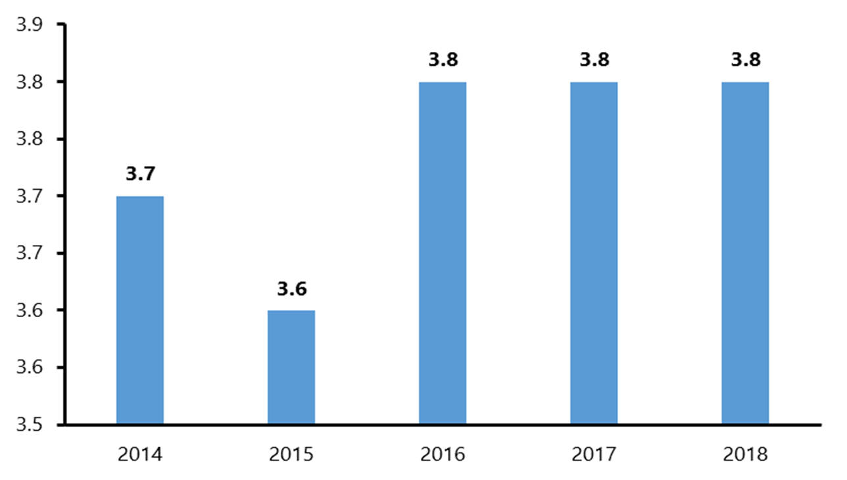
Annual GDP Growth Rate, Per cent

Slide 16
Contribution to GDP Growth (Percentage point)

Slide 17
Inflation Rate and Core inflation, Per cent

Slide 18
Terms of Trade

Slide 19
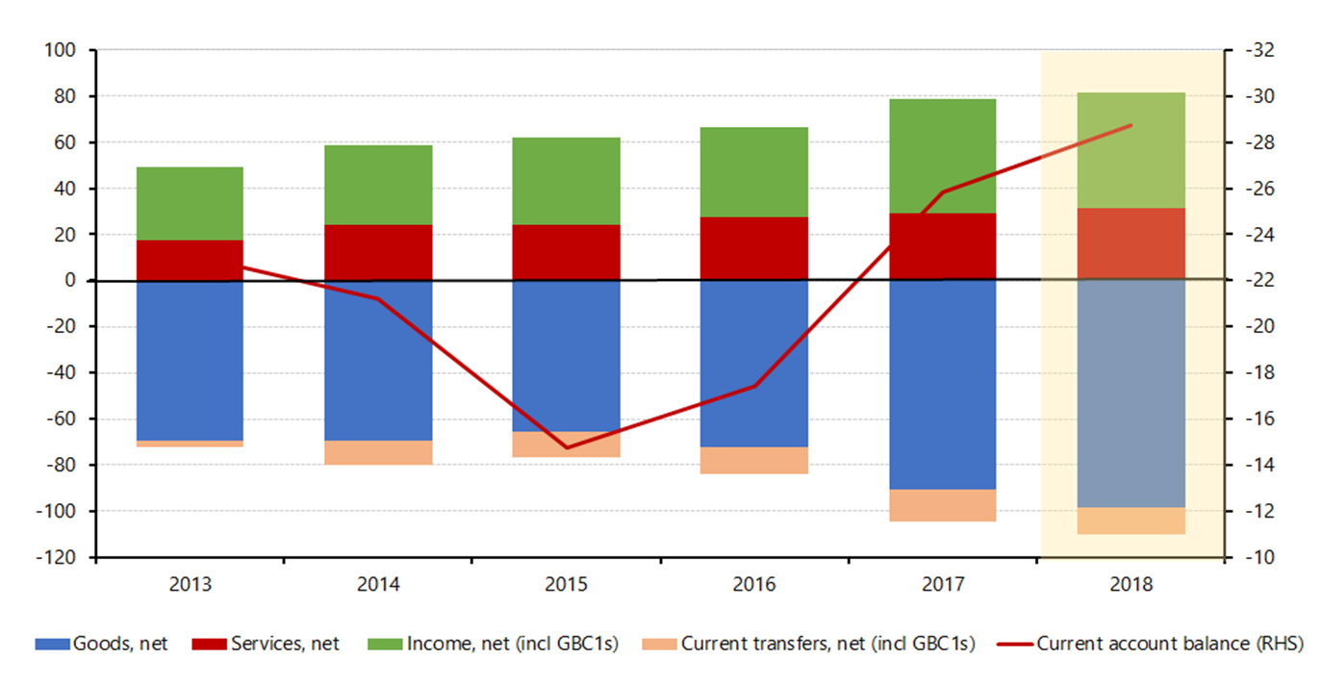
Current Account Balance, Rs Billion

Slide 21
Challenges
Uncertain and weakening global economic and financial environment;
Ageing population;
Declining competitiveness and low innovation;
Labour shortages and skills-mismatch; and
Public debt currently sustainable, but vigilance warranted.
Bank of Mauritius

