Slide 1
AACB Work session 2: Development of an integrated inter-regional mobile payment strategy
Tim Masela
Cairo – April 2019

Slide 2
Current landscape
Cost drivers for low value payments/transfers
How expensive are corridors on the African continent?
Causes of inefficiency
Conclusions based on current landscape

Slide 4
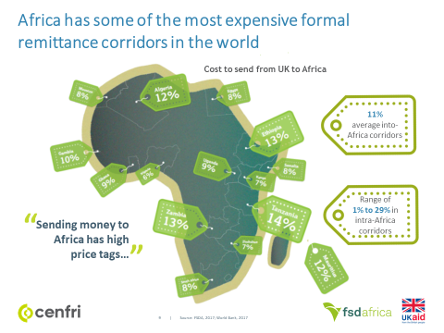

Slide 7
Development of an integrated inter-regional mobile payment strategy should lead to;
A harmonized regulatory framework supporting intra-regional remittance type payments;
Standardized and harmonized operating components enabling seamless integration;
Safe and streamlined same day inter-bank settlement of intra-regional obligations arising from these payments/transfers via public sector settlement infrastructures; and
Use of best practices in aspects such as security and consumer protection etc.

Slide 8
This initiative could be actioned as follows;
Establish a public private partnership to execute the initiative;
Sensitise stakeholders on the rationale for this initiative;
Seek stakeholder commitment and assurances for alignment of efforts to execute the initiative; and
Agree a planned approach, progress monitoring mechanisms and timelines.

