Slide 1
Development of an Inter-regional Payment System Integration Framework Workshop Infrastructures or Initiatives on the Continent: Case of the Southern African Development Community (SADC)
Association of African Central Banks (AACB) Cairo, Egypt
18 April 2019
Ms Nomwelase Skenjana, SARB

Slide 2
Topics to be covered
The Southern Development Community (SADC)
SADC Institutional Arrangements
SADC Payment System Subcommittee
SADC Payment System Project : Vision
SADC Payment System Project : Modernisation
SADC Payment System Project : Integration
SADC Payment System Project : Regulatory Regime
SADC Payment System Project : Integration Business model
SADC RTGS in numbers
SADC Payment System : Current Initiatives

Slide 3
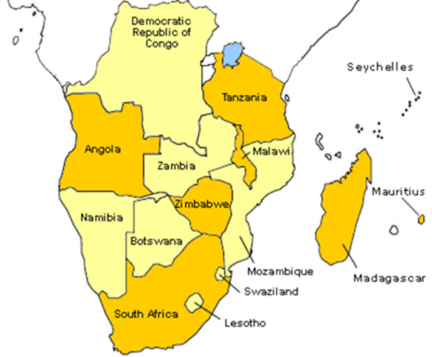
1. Southern African Development Community
16 member countries, including Comoros which recently joined
Co-operate on matters pertaining to finance and investments within the region.

Slide 4
2. SADC Institutional Arrangements
SADC Summit (Head of States)
SADC Council of Ministers
Committee of Central Bank Governors (CCBG)
Banking Supervision
Financial Markets
Payment System
SADC Banking Association
SADC Committee of Ministers responsible for Finance and Investment
Sub-Committees include
CCBG Secretariat
Notes:
incorporates the SADC Payment System Oversight Committee
The SADC Banking Association was established to coordinate the cross-border banking activities of its members. These activities include influencing policy, interacting with stakeholders, and initiating projects that can contribute to sustainable banking and investment policies and activities in the SADC region. Being in the cooperative (non-competitive) space, the focus of the SADC Banking Association’s interventions is to define payments instruments, business rules, and messaging standards for interbank use.

Slide 5
3. SADC Payment System Subcommittee
Mandate is drawn from SADC Protocol on Finance and Investment (FIP)
Oversees the implementation of the Annexure 6 of the FIP
Co-operation on Payment Systems, Clearing and Settlement Systems
Annexure 6 of the FIP aims at:
Implementation of safe and efficient payment system in each Member State
Development of cross border payment strategy for the region
Each Member State Central Bank appoints one person to serve on the Sub-committee
Informed the Vision of the SADC Payments Project

Slide 6
3.1 Interaction with International and Regional Bodies
For the SADC PS Integration Project , there is cooperation and engagement with other regional bodies and international bodies. Activities include;
Funding,
Training and
sharing of information.
Common Market for Eastern and Southern Africa
The World Bank
Bank for International Settlement
East African Community
International Monetary Fund

Slide 7
4. SADC Payment System Project : Vision
Each SADC country should have:
A safe and efficient payment system which is:
Internationally acceptable;
Interlinked within the region; and
Supporting the aims of SADC Trade and investment.

Slide 8
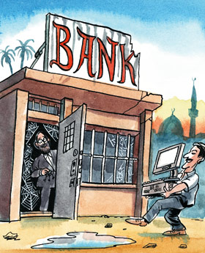
5. SADC Payment System Project: Modernisation of Payment Systems

Slide 9
5.1 Modernisation : Primary Initiatives
8
Develop Domestic Vision and Strategy | Promulgate of National Payment System Acts | Establish of National payment system departments or divisions within the respective SADC central banks | Developed and implemented of domestic RTGS | Developed domestic oversight functions and frameworks | Domestic RTGS interlinked with Central Securities depositories to achieve delivery versus payment (DvP) | Implemented of domestic Retail Payment infrastructures for different payment streams/schemes | Introduced and enhanced mobile payment and mobile banking initiatives to support financial inclusion
Stocktake yet to be conducted and analysed for each country
14
Modernised
Modernisation: RTGS Implementation
Plans to modernise
1
No Plans as yet
EXCLUDING COMORS
Notes:
This approval was granted in line with the objectives set in the SADC Regional Indicative Strategic Development Plan (RISDP) to have a single regional currency by 2018

Slide 10
6. SADC Payment System Integration : Strategic Objectives
Strategic objective 1: Enhance (harmonise) the regional legal and regulatory frameworks to facilitate regional clearing and settlement arrangements
Strategic objective 2: Implement an integrated regional cross-border payment settlement infrastructure (business, technical and system)
Strategic objective 3: Implement an integrated regional cross-border payment and post-trade clearing infrastructure
Strategic objective 4: Establish a co-operative oversight arrangement based on the harmonised regulatory framework for regional cross-border payment and settlement among participating member countries
No SADC law
Current SADC-RTGS Legal Framework
Contractual arrangements
Harmonisation of legal and regulatory framework
Completed Countries and SADC-wide assessment
SADC Payment System Model Law
SADC RTGS
SADC PSMB
- Beige Book
SADC RCSO for Retails payments
Securities - DvP
SADC Payment System Oversight Committee
MoU for Co-operative oversight arrangements
Recognition of SADC PSMB
Participating Central Banks
member countries can discharge their oversight policy objectives within the regional clearing and settlement system

Slide 11
7. Regulatory Regime

Slide 12
7.1 SADC-RTGS Legal Framework : Contractual arrangements
SARB
(SADC-RTGS System Operator)
SADC Central Banks
SADC-RTGS
Participants
Appointment of the SARB as SADC-RTGS System Operator
Stakeholders Agreement
SADC-RTGS
Service Agreement.
SADC-RTGS Participant Settlement Agreement.

Slide 13
7.2 SADC-RTGS Governance Arrangements
Ensure compliance with CPMI IOSCO standards eg PFMIs
Oversee SADC-RTGS & RCSO and functions as:
Access Criteria
Disputes
Finality
SADC PSOC
SADC-RTGS
SADC PSMB
IMMS
LVT
RCSO
SLA’s & other operating agreements
Payment Scheme Rule Book
DVP
Payment Scheme

Slide 14
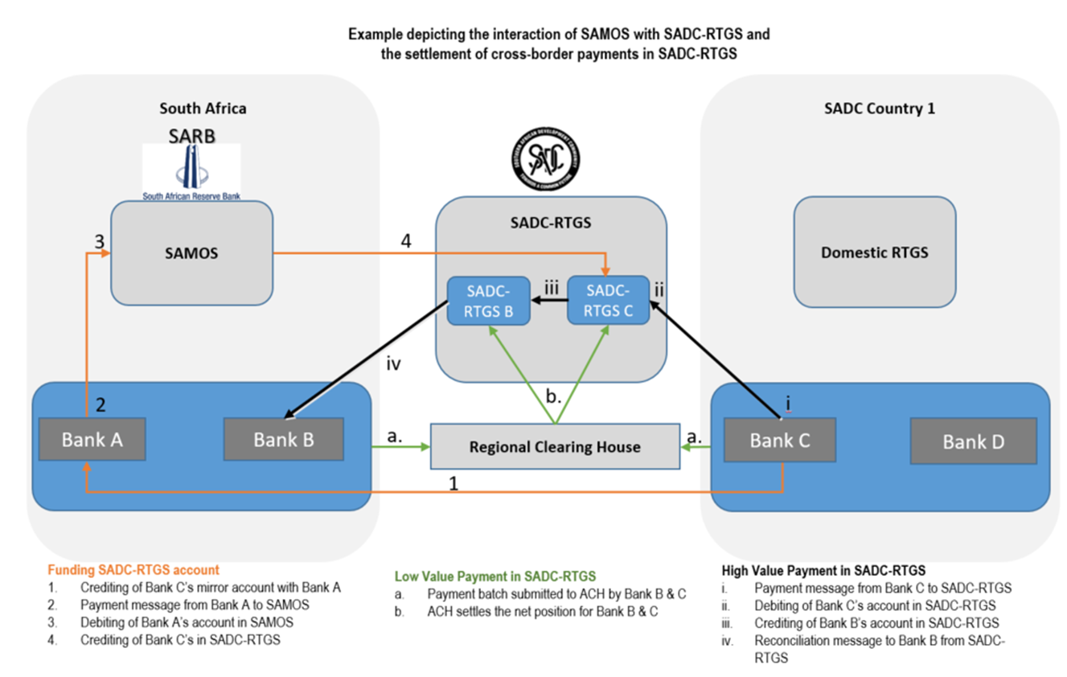
8. SADC-RTGS Business Model
SAC-RTGS

Slide 15
9. SADC-RTGS in Numbers : February 2019
Total number of transactions to date (million)
Total value to date ZAR (trillions)
Number of participating countries
Number of active participating banks
Number of participants terminated since inception
1.36
5.52
28 000/monthly
Notes : 14 countries
1 country is in a Testing phase
New member
14
1200+/daily
81
7

Slide 16
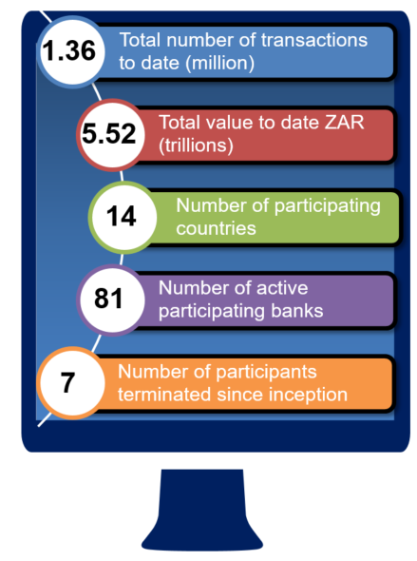
9.1 SADC-RTGS in Numbers: February 2019

Slide 17
9.1 SADC-RTGS in Numbers: February 2019
Peak volume month: Oct 2018 (32 059 transactions settled)
Peak value month: Aug 2017
( ZAR 119.53 Billion settled)
Average value of Customer payments: ZAR 562 685.83
Average value: Interbank payments: ZAR 20.29 Million
Highest daily volume and value since inception:
#: 2 780 – Apr 2018; Val: ZAR 11.4 Billion – Dec 2018

Slide 18
10. SADC Payment System Current Initiatives
SADC Payment System Integration Model
Infrastructure Renewal and Replacement (ISO20022)
Implementation of cross border low value person to person payment scheme
Introduction of the USD and other SADC currencies in the SADC-RTGS
ALM/CFT
SADC-RTGS Operator: Cyber Security Framework, End point Security and SWIFT CSP
World Bank Remittances assessment report
Implementing recommendations
Established a SADC Fintech Workgroup

Slide 19
Abbreviations
Term | Description
CCBG | Committee of Central Banks Governors
DVP | Delivery Versus Payment
FIP | Protocol on Finance and Investment
IMMS | Immediate Settlement
LVT | Low Value Transactions
MoU | Memorandum of Understanding
RTGS | Real Time Gross Settlement System
SADC | Southern African Development Community
SADC PSMB | SADC Payment System Management Body
SADC PSOC | SADC Payment System Oversight Committee
SADC RCSO | SADC Regional Clearing and Settlement Operator
SLA | Service Level Agreement
ZAR | South African Rand

Slide 20
E n d

